Slide 1










AI-Powered Accounting Solutions
AI for Accounting: Transforming the Profession
Exploring how artificial intelligence is revolutionizing accounting workflows, automating repetitive tasks, and enabling accountants to focus on strategic initiatives.
Automation
Analysis
Accuracy
One-click download
Multiple formats available

Slide 2








Why Accounting is AI-Ready
Accounting processes possess key characteristics that make them ideal candidates for AI automation and transformation.
Repetition
Structured Datasets
Rules-Based Categorization
Accounting involves repetitive tasks that AI can perform with consistent accuracy and efficiency.
Financial data is typically organized in predictable formats, making it ideal for AI processing.
Accounting relies on established rules and classifications that AI can learn and apply.
Pattern Recognition
High-Volume Accuracy
Document Validation
AI can identify trends and anomalies in financial data that humans might miss.
AI handles large volumes of transactions with consistent accuracy, reducing manual effort.
AI can verify and validate financial documents, ensuring compliance and reducing errors.
AI automates repetitive tasks while humans handle judgment, ethical decisions, context, and strategy.

Slide 3














AI vs Human Roles in Accounting
The future of accounting lies in the collaboration between AI automation and human expertise
AI Roles
Human Roles
Repetitive Tasks
Judgment & Decision Making
Handles routine processes like data entry, invoice processing, and transaction categorization
Makes subjective assessments and strategic financial decisions
Data Processing
VS
Ethical Decisions
Processes large volumes of financial data with high accuracy and speed
Navigates ethical dilemmas and maintains professional skepticism
Pattern Recognition
Contextual Understanding
Identifies trends, anomalies, and patterns in financial data
Interprets financial data within business context and strategic goals
Document Analysis
Extracts and processes information from invoices, receipts, and financial documents
Strategic Planning
Develops long-term strategies and provides forward-looking insights
The most effective accounting approach combines AI automation with human expertise

Slide 4















Data Processing & Document Automation
AI extracts, transforms, and processes financial data while automating document workflows.
Source Documents
OCR Extraction
Data Transformation
GL Coding
Key Benefits
Real-World Examples
Time Savings
QuickBooks OCR
Reduces manual data entry by automating extraction and processing.
Extracts data from bills and invoices for automated processing.
Accuracy Improvement
Excel "Insert Data from Picture"
Minimizes errors through automated validation and verification.
Copies data from images into spreadsheets with a single click.
Document Linking
Google Sheets Duet AI
Connects related documents to transactions for better tracking.
Suggests table structures from unstructured data.

Slide 5



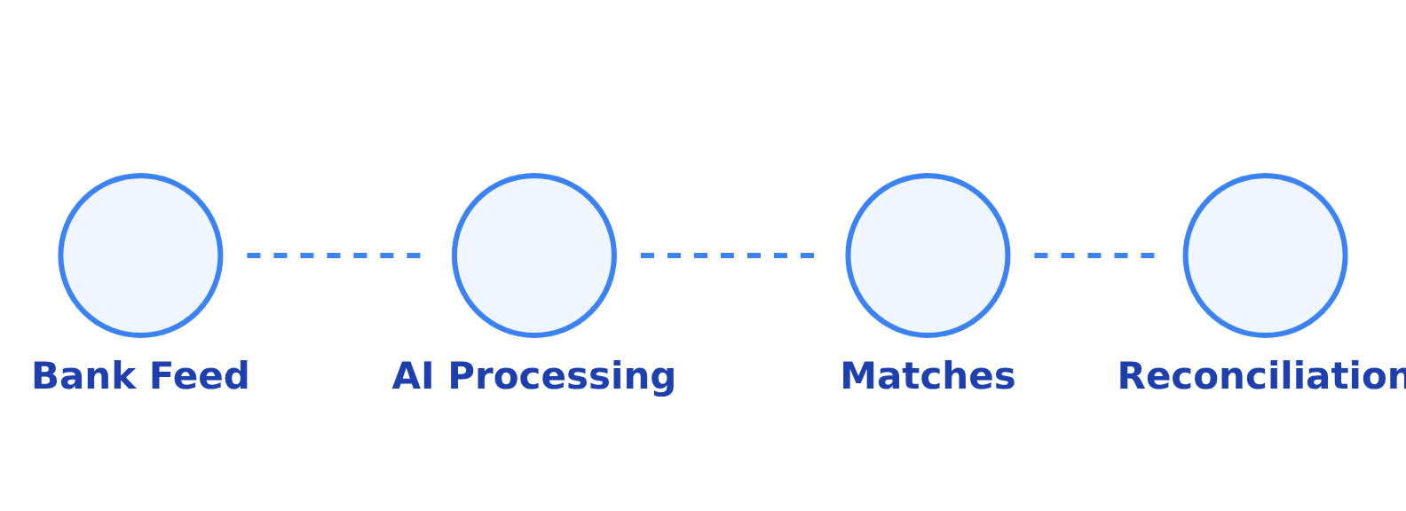









Bank Reconciliation & Transaction Matching
AI enhances bank reconciliation by automating routine tasks and providing intelligent insights.
Predict Categories
AI-Powered Bank Reconciliation Process
AI automatically categorizes transactions based on patterns and historical data.
Suggest Matches
AI connects transactions to bills, invoices, or other financial activities.
Flag Anomalies
AI highlights unusual transactions for review.
Example Tools
QuickBooks Smart Matching
Identify Missing Items
Sheets Duet AI Extraction
AI detects missing transactions or discrepancies between systems.

Slide 6










Accounts Payable & Receivable Automation
AI streamlines invoice processing and optimizes cash flow management.
Accounts Payable Automation
Accounts Receivable Automation
Invoice Routing
Late Payment Prediction
AI routes invoices to approvers based on spend rules and authorization limits.
AI analyzes payment history to forecast late payments.
Personalized Reminders
GL Code Suggestions
Systems generate customized reminders for timely payments.
Systems suggest appropriate GL codes based on vendor and spending patterns.
Follow-up Prioritization
AI ranks invoices by priority based on payment risk.
Duplicate Detection
Receipt Forecasting
AI identifies and prevents duplicate payments, saving money.
Predicts cash flow based on historical payment trends.
Early Payment Opportunities
System identifies invoices with early payment discounts.
Examples: Chaser, GPT for Sheets
Examples: Bill.com, Excel Copilot
AI handles repetitive aspects of AP/AR, allowing staff to focus on relationships and exceptions.

Slide 7












Fraud Detection & Risk Monitoring
AI enhances security by identifying suspicious behaviors and highlighting anomalies in financial data.
AI Capabilities in Fraud Detection
Recommended Tools
Suspicious Behavior Detection
MindBridge
Identifies patterns and activities that deviate from normal behavior, flagging potential fraud attempts.
AI-powered audit and risk assessment platform
Excel Copilot
Outlier detection and anomaly identification
Duplicate Transaction Flagging
Recognizes and flags duplicate or suspicious transactions that may indicate fraudulent activity.
Real-World Application
AI identifies vendor inconsistencies and highlights GL entries outside expected ranges, enabling proactive risk management.
Unusual GL Entry Monitoring
Highlights general ledger entries that fall outside established parameters or expected ranges.
AI enhances security while reducing false positives
Page 7 of 10

Slide 8











Financial Analysis & Reporting
AI transforms financial data into strategic insights through automated analysis and visualization.
Automated Forecasting
Trend Identification
AI-Powered Tools
AI analyzes historical data to build predictive models and forecast future financial performance.
AI detects emerging trends and patterns in financial data that might be missed by traditional analysis.
Fathom
Specialized financial forecasting and analysis
Excel Copilot
Variance Analysis
Automated Dashboards
Financial modeling and variance analysis
AI explains differences between expected and actual results, highlighting key factors driving changes.
AI creates interactive dashboards that visualize key performance indicators and financial metrics.
Case Example
AI identifies unusual expense patterns, investigates root causes, and recommends cost optimization strategies.
"AI reduces busywork and increases accuracy, allowing accountants to focus on analysis and strategy."
Page 8 of 10

Slide 9

















AI Tools & Implementation
Key AI-powered solutions transforming accounting workflows
Spreadsheet & Document AI
Accounting Automation
Specialized Financial AI
Excel Copilot
AP Automation (Bill.com)
Fraud Detection (MindBridge)
AI assistant for data analysis and reporting
Invoice routing and payment processing
Anomaly detection and risk scoring
Bank Feeds & Reconciliation
Tax Solutions (Avalara)
QuickBooks OCR
Smart Matching for transaction matching
Tax calculation and compliance
Extracts data from documents
Implementation Strategy
Start with data preparation
Train staff on AI tools
Integrate gradually

Slide 10






Partnering with AI for Success
The future of accounting lies in the partnership between human expertise and AI automation.
Reduce Busywork
Increase Accuracy
AI automates repetitive tasks like data entry, reconciliation, and document processing, freeing accountants from mundane work.
AI processes transactions with consistent accuracy, reducing errors while humans focus on complex judgment calls.
Strategic Analysis
Client Advisory
With routine tasks automated, accountants can focus on high-value analysis, insights, and strategic decision support.
AI handles the data processing while accountants provide valuable advisory services to clients.
"The accountants who embrace AI will be the ones who thrive in the future of our profession."
AI enhances our value, doesn't replace us
10/10

